Slide 1

SARS COVID-19 Detection Through AI
Fall 23 - CS692 - Capstone Project Pace University
Subject: CS691
Prof. Henry Wong

Slide 2

Agenda

Slide 3

Agenda
AI has been used to develop diagnostic tools for COVID-19, such as image recognition algorithms that can identify COVID-19-related patterns in medical imaging, like chest X-rays or CT scans. These tools can help healthcare professionals make more accurate diagnoses. AI algorithms can handle massive datasets related to COVID-19. This capacity is essential for analyzing and understanding the virus's behavior and its impact.
SARS-CoV-2 detection AI models require access to a large and diverse dataset for training. Personal and sensitive information must be properly anonymized to protect patient privacy. COVID-19 data can be noisy and inconsistent. Preprocessing should include data cleaning and normalization to remove outliers, errors, and duplicates. When collecting patient data, ensure proper informed consent and transparent data usage policies.
The ongoing COVID-19 pandemic has highlighted the potential of AI to transform our approach to infectious disease response. AI can analyze patient data to tailor treatment plans, optimizing care for individual patients and potentially reducing adverse effects. AI systems can monitor and analyze adverse events related to drugs or treatments, enhancing patient safety.
AI-driven image analysis techniques have been used for COVID-19 detection. AI has played a crucial role in addressing various aspects of the COVID-19 pandemic. deep learning models can analyze medical images, like X-rays or CT scans, to identify COVID-19-related patterns in lung tissue. This aids in quicker and more accurate diagnosis.
It can record and display a user's past interactions and actions within the system. This helps users track their history and understand what they've done. User history can be used for security and auditing purposes, providing a record of who accessed what information and when. Associating X-ray images with patient names or identifiers is crucial for proper patient identification. It ensures that the right images are linked to the right individuals' medical records.

Slide 4



Team Members Roles and Responsibilities
Anusha Nunna
(Developer)
Venkatesh
(Quality Analyst)
Reshma Gonu
(Developer)

Slide 5
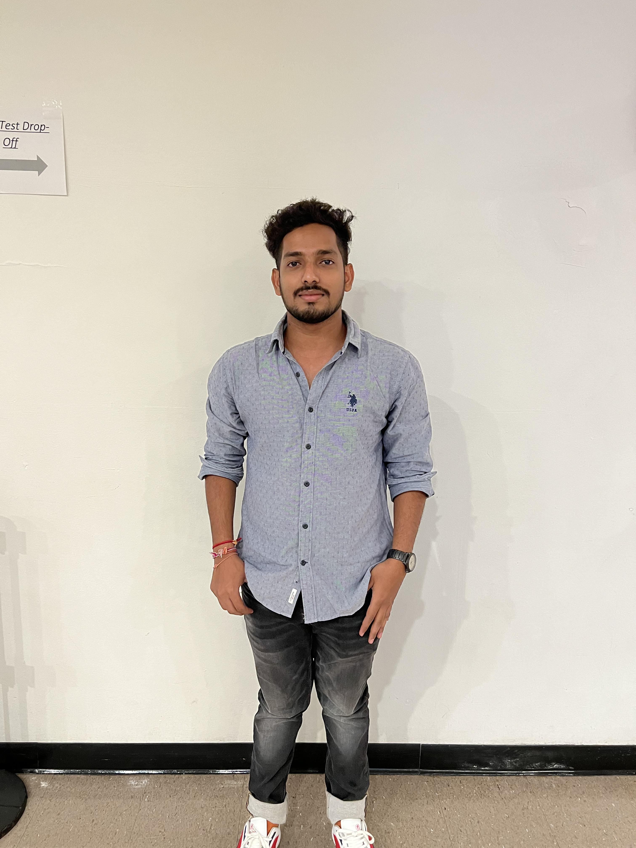


Team Members Roles and Responsibilities
Vamshi
(Product manager)
Alekhya
(Facilitator)
Hanith atluri
(Tester)

Slide 6
Improvements made from Professor Feedback
Need to correct the role name in team member’s slide.
→ In response to the professor's feedback, we've made the necessary adjustments to the role name this time.
Need to provide a verbal explanation while demonstrating the functionality of an MVP application.
→During the previous sprint, our MVP demo lacked audio. However, this time, we've rectified this issue by including both audio and a functional video.
Need to present good team velocity chart and burndown chart, required to explain about velocity report and burndown chart in the video presentation.
→ We have addressed the professor's feedback by providing an explanation of the velocity report and burndown chart.
It is necessary to include the story point estimate and note that the acceptance criteria is not presented on a separate slide rather, it's integrated into the user story itself.
→This time we have mentioned the story point estimate. Also, we mentioned the acceptance criteria in user story.
Require improved diagrams.
→ We have furnished explicit diagrams.

Slide 7

Project Description

Slide 8
Project Description
Project Name: | SARS Covid-19 detection through AI
Team: | Mission Possible
Project description: | For users Who want to know their feedback on covid-19 reports the let it free Is a web app That checks users reports and provides the accurate result Unlike if users not able to go hospitals in the covid-19 situation Our application will help them to submit their reports and they can get their accurate result. Based on their result they can order the medical kit and they can make an appointment to the doctors as well.
Benefits outcomes: | It the users can use our application they can easily get their covid-19 accurate feedback. Based on that they can order the tool kit and they can take the precautions s well.
github link: | https://github.com/htmw/2023S-Team4/wiki

Slide 9
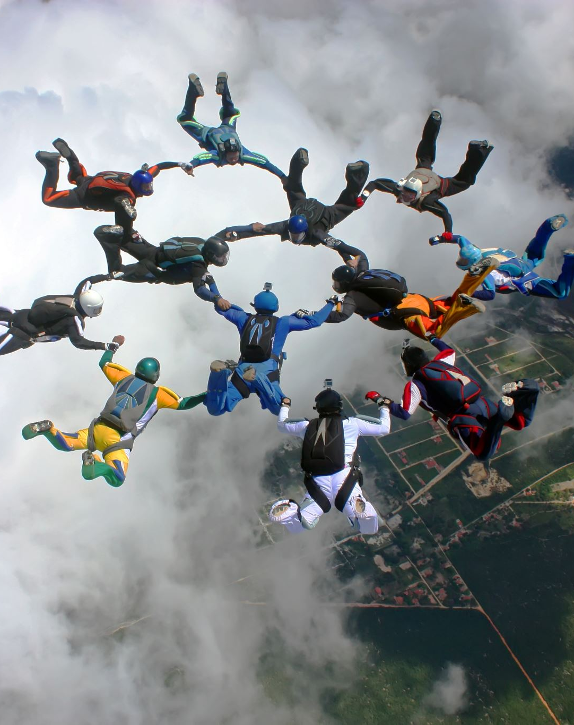
Team working agreement
Every week, the team members discuss the project's status, obstacles, and next steps. The tasks are split up during the meeting.
Team members discuss any challenges they face and give status updates on their tasks in our WhatsApp group chat.
We rely on every team member to be accountable for their tasks and deliverables within the established timeframes.
To ensure that every team member is aware of their responsibilities and feels comfortable carrying them out, we place a high importance on openness and communication.
My team and I have been engaging in discussions where we acknowledge our errors and work collaboratively to address and correct them.

Slide 10
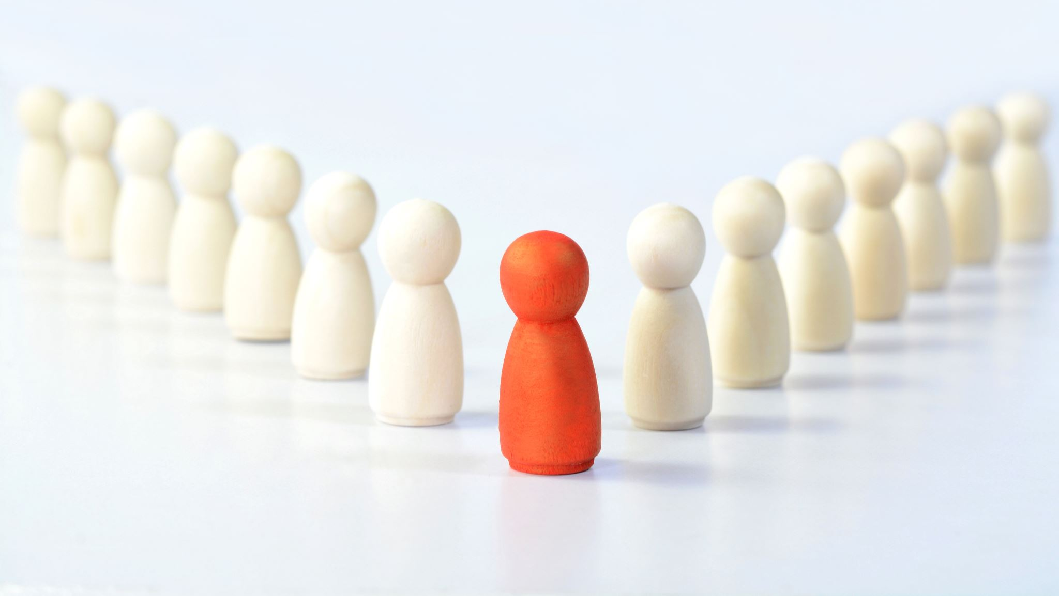
Personas (at least 3)

Slide 11
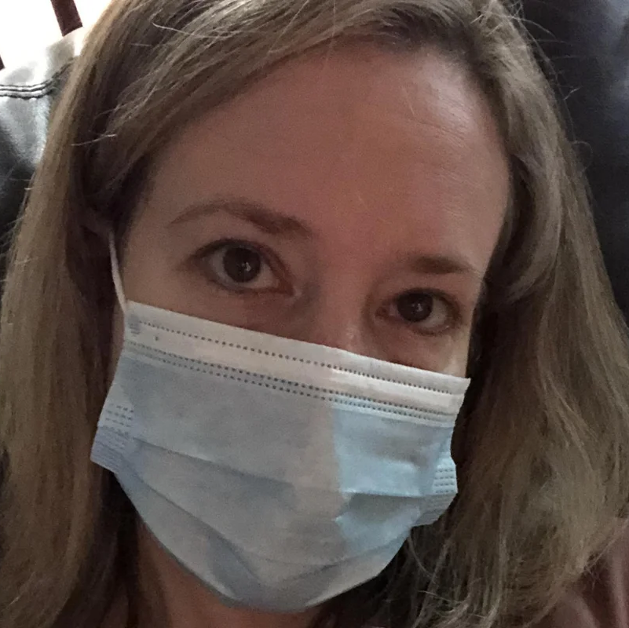
Persona-1
Name: MAYA
AGE: 34 YEARS
GENDER: FEMALE
Working professional Maya is concerned about her health and wants to know her current COVID-19 status. She has been undergoing routine COVID-19 testing because of the safety procedures at her job.
To maintain her safety and compliance with workplace regulations, Maya must maintain a record of her past and current COVID-19 test results. Also, she wants to receive the results promptly. For her peace of mind, having easy access to her test findings is essential, through this personal data form feature she can have that access.

Slide 12
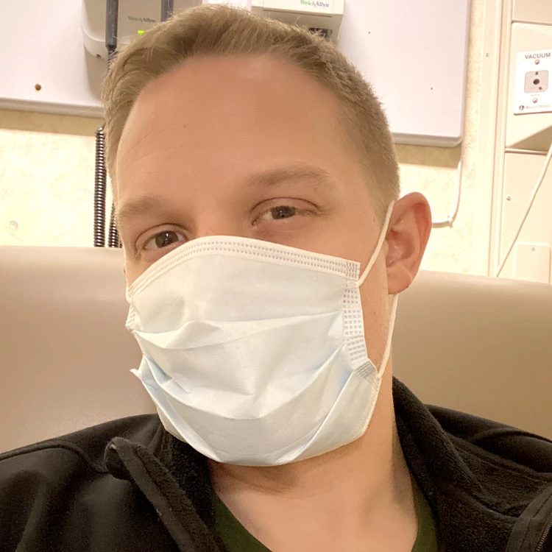
Persona-2
Name: DAN
AGE: 41 YEARS
GENDER: MALE
Dan works for a software development company as a project manager. Owing to his hectic work schedule and sporadic stress, he is dedicated to keeping himself healthy and routinely gets checked out for a variety of conditions, such as blood pressure and cholesterol. He wishes to monitor his health parameters closely.
For some months, Dan has been gathering health reports to keep an eye on his general health. In order to give him a clear image of how his health has been trending, he would want to obtain an average analysis of his numerous reports. With this knowledge, he will be able to make well-informed judgments regarding his lifestyle and possibly pinpoint any areas that need more attention and through this analysis feature he can achieve it.

Slide 13
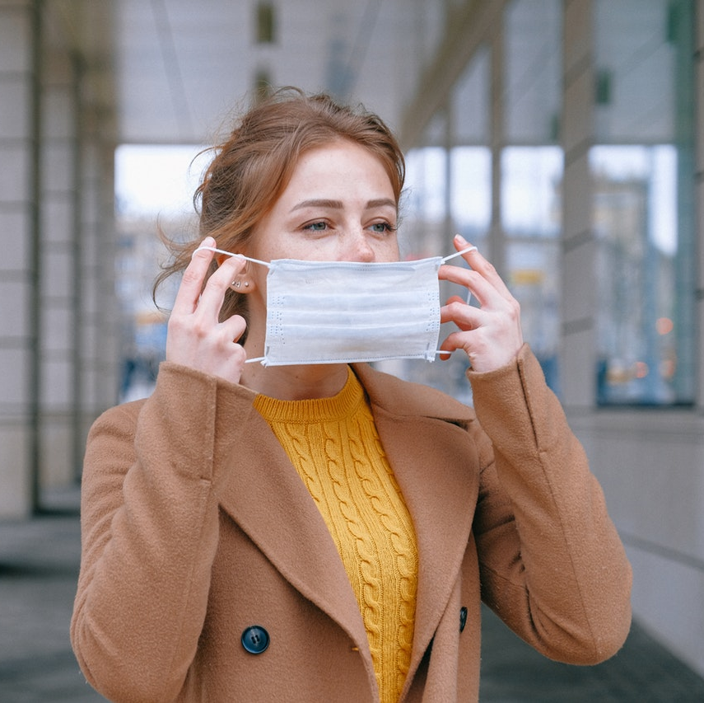
Persona-3
Name: SNEHA
AGE: 37 YEARS
GENDER: FEMALE
A busy marketing manager, Sneha manages her personal, professional, and family lives. She frequently finds it difficult to arrange and keep in-person doctor appointments because of her rigorous work schedule and her family obligations. When it comes to medical services, she prioritizes effectiveness and convenience.
Sneha needs to be able to easily schedule doctor's appointments, particularly when she or her family members need medical advice. In order to save time and avoid making in-person trips to the doctor, she chooses to utilize her app to book doctor appointments and conduct the consultations via Zoom or Google Meet. This strategy protects her health and the health of her loved ones while enabling her to successfully manage her career and family responsibilities. Through this doctor appointment scheduling feature, she can achieve it.

Slide 14

MVP
The minimal viable product (MVP) of this project will enable us to upload a CT-scan document from a patient with chronic obstructive pulmonary disease and check the current state of the report.
To keep track of a user's information, such as their symptoms and any relevant travel history, so that doctors may get a better picture of their patients more quickly.
a dedicated scheduling section where patients can request appointments with their preferred doctors within 30 minutes of the doctor's preferred time and availability.

Slide 15
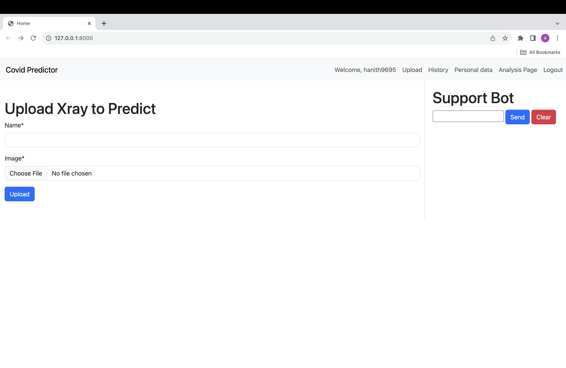
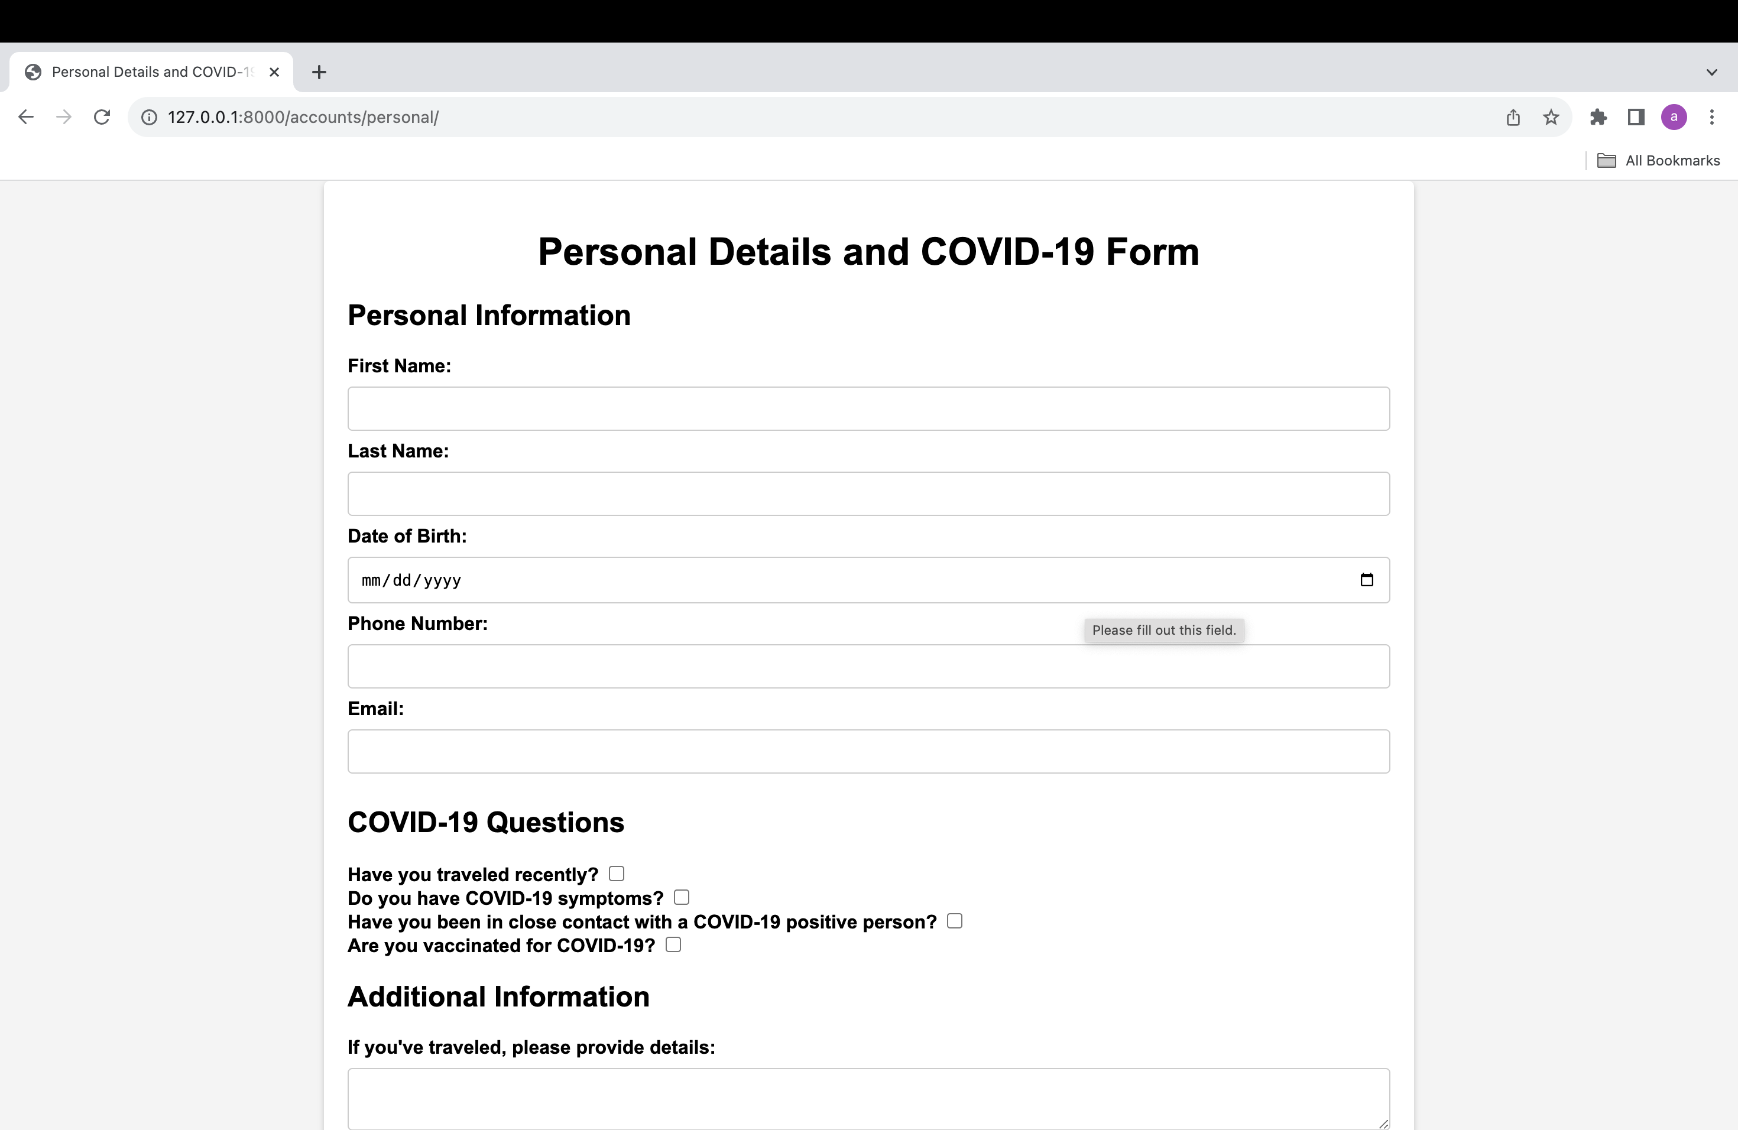
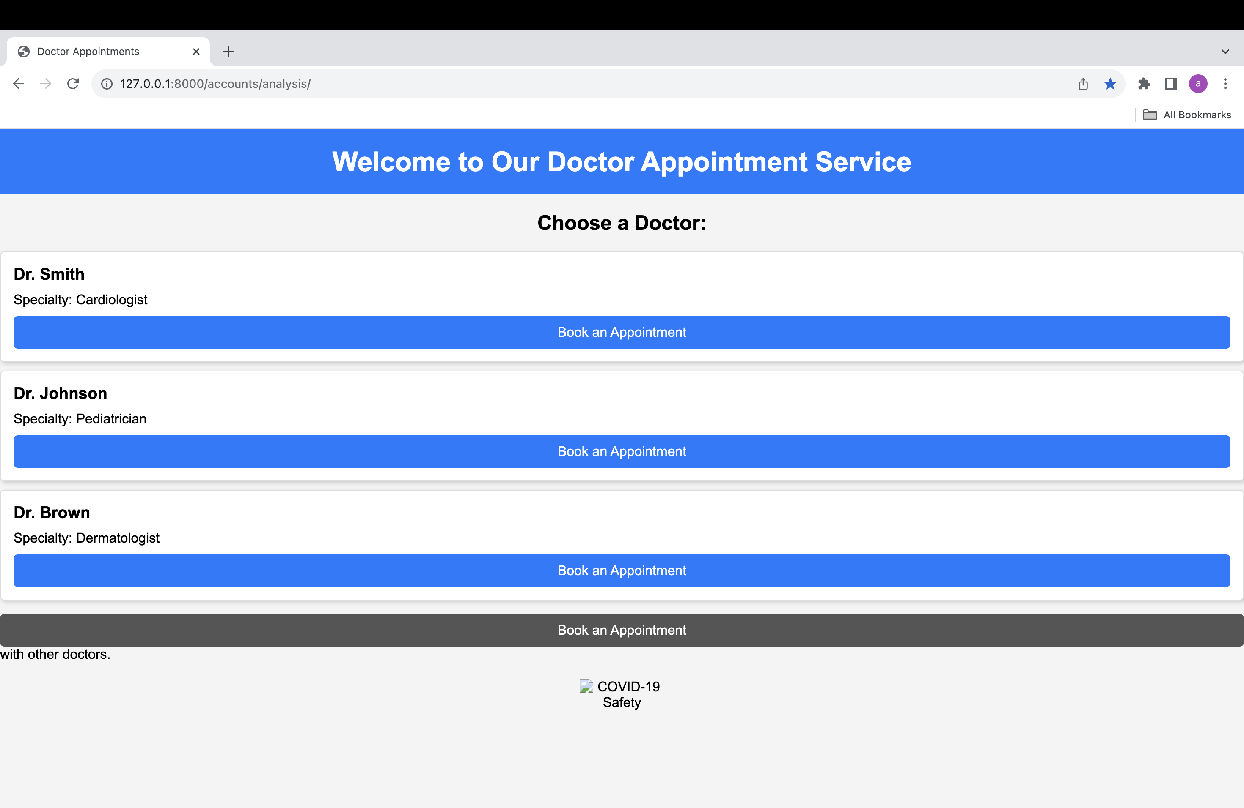
Screenshots

Slide 16







Algorithms & Technologies

Slide 17
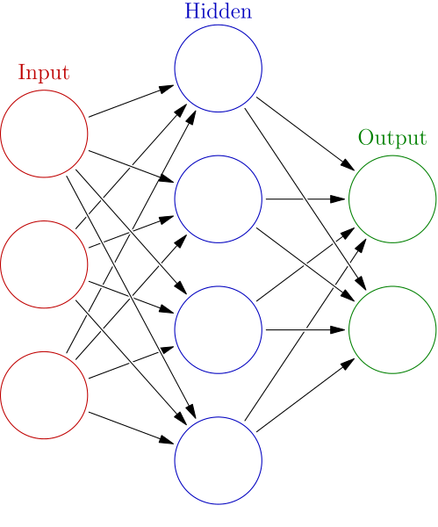
Convolutional Neural Networks (CNNs):

Slide 18
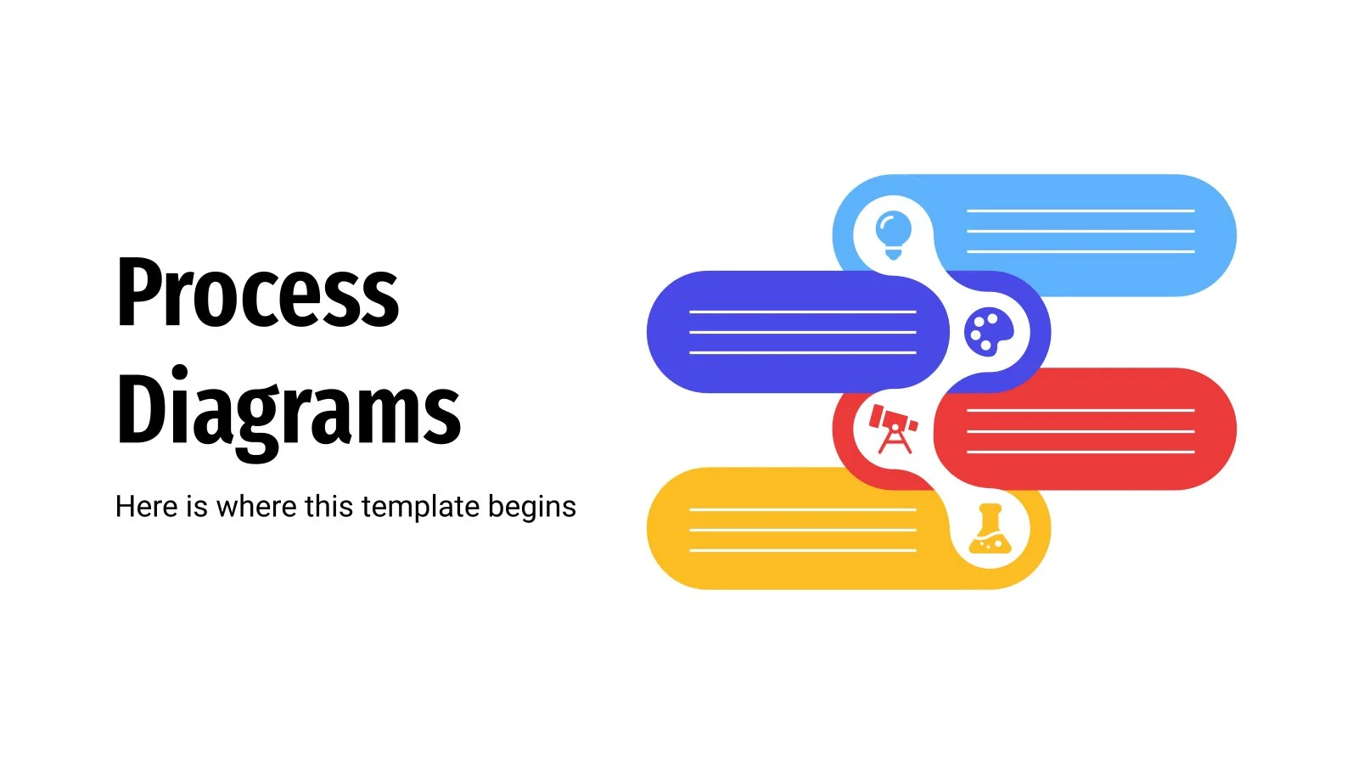

Slide 19

ML Diagram
Collect Covid Images
Prepare Data for Training
Design & Construct Model
Train Model
Validate & Improve Model
Test Model on New Image
Analyze the Predicted Result

Slide 20
System Architecture
Learning Algorithm
Covid Image
Train Set
Train Model
Image Preprocessing
Feature Engineering
Validate Model
Test Set
Predicated Result

Slide 21
Sequence Diagram
User
Data Storage
CNN
Create Trainset & Testset
Construct CNN Model
Collect Image
Store Image Files
Extract features
Train Model
Validates evaluated model
Save Model & Weights
Generate performance report
Load pre-trained Model Images
Collect Image
Predict label
Output
Result

Slide 22

Dataflow Diagram
Training images with label
Labeled Images
Pre-processing and image-frame conversion
Processed frames
Image preparation for training
Construct and train model
Model Graph
User
Test Image
Test Image
Pre-processing and video-frame conversion
Trained and saved model
Predicted label

Slide 23
Flow-chart Diagram
START
Upload Dataset with label
Image Preprocessing
Feature extraction using CNN
Train CNN
Input Test Image
Classify Test Image
Display Result
STOP

Slide 24



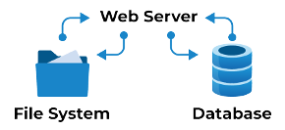

Conceptual Architecture Diagram
Upload Image
Upload Image
Frontend
Display Results
Display Results
Users
Backend

Slide 25
Recap of sprint-5
In the previous session we have discussions about the remaining features to be developed.
We have discussed about the MVP features and options and initiated developing the MVP core features.
Provided team performance metrics and pertinent Key Performance Indicators.
Highlighted pending tasks and described strategies for addressing them.
Reported the proportion of completed test cases in the current sprint.
Summarized significant insights and actionable steps identified during the retrospective meeting.

Slide 26
User stories
Key | User Stories Summary | Place
SC1DTA-204 | As a user, I want to register myself to the portal . So that I can keep updating my medical health condition | Portal page
SC1DTA-207 | As a user , I want to login into the portal . So that I can keep updating all my personal information | Portal page
SC1DTA-212 | As a user , I want to upload my reports in the portal so that to get more accurate medication | Upload
SC1DTA-316 | As a user, I want to view my reports through portal and their result | History
SC1DTA-312 | As a system, I need to compare current lab results to previous results to detect potential issues | History
SC1DTA-318 | As a user , I want appointment reminders, So I don’t forget about upcoming visits | Appointment
SC1DTA-280 | As a user, I need to upload the basic information regarding the travel history/symptoms of current day | Personal

Slide 27
User stories
Key | User Stories Summary | Place
SC1DTA-316 | As a user, I want to know the symptoms of disease and risk factors of the disease | appointment
SC1DTA-223 | As a user, I want to be able to edit my personal details | Personal
SC1DTA-225 | As a user, I need to see the appointment details through mail | appointment
SC1DTA-220 | As a user, I want to know the risk of disease about me after I upload my reports from doctor | appointment
SC1DTA-222 | As a user, I want to know the see the percentage of factor in which uploaded files | upload

Slide 28
USER STORIES AND ACCEPTANCE CRITERIA
User Id | Scenario | User Stories Summary | Status
SC1DTA-280 | 1. Customer want to enter personal details Given I’m in the role of customer When I open the portal signup page Then I click on to personal details And I can see all the details of the clinic | As a customer I want to enter my demographics like name, date of birth, address, contact information so that clinic the clinic has my details on file | Done
SC1DTA-316 | 2. Customer want to check the medical history Given I’m in the role of the customer When I open the history page Then I want to see the medical track which CT scan which I have uploaded before. | As a customer I want to view my health trends over time so that I can track my progress | Done

Slide 29
USER STORIES AND ACCEPTANCE CRITERIA
User Id | Scenario | User Stories Summary | Status
SC1DTA-318 | 3. Customer want to the schedule appointments with healthcare providers Given I am in the role of customer When I open the calendar page Then I want to see the schedule appointment date I took before And I see all the appointment details through healthcare website | As a customer I want to easily schedule appointments online. So that I don’t have to call the clinic | done
SC1DTA-220 | 4. Customer want to see the medical history Given I am in the role of the customer When I open the medical history Then I want to schedule an appointment with doctor to get necessary medications. | As a customer I want to provide my medical history like conditions, medications, surgeries. So that the clinic can identify any potential risk factors | done

Slide 30
TEST CASES
Test case for | Key | Test data | Expected results | Actual results | Pass/fail
User portal | SC1DTA-3O9 | User details (login details) | Users should be able to upload the CT-scan in the portal | Login->upload | p
User portal | SC1DTA-309 | User details (login details) Update message | User should be able to update the details | Login-> personal->send | p
History page | SC1DTA-311 | User logged into the portal | User should be able to send the updates via portal | Login ->dashboard | P
History page | SCIDTA-311 | User logged into the portal | User can check the past result | login-> history | P
Schedule appointment | SC1DTA- 313 | User logged into the calendar | User can schedule the appointments | Login->appointment | P

Slide 31
SPRINT-6 BACKLOG
Issue type | key | Name | Story Estimated Points
story | SC1DTA- 309 | As a user , I want to enter my current medications and dosage, So my medication list is up o date | 2
story | SC1DTA-310 | As a user, I want to add my medical history so potential risk factors are documented | 3
story | SC1DTA-312 | As a system , I need to compare current lab results to previous results to detect potential issues | 2
story | SC1DTA-313 | As a user, I want to receive email reminders 30-mins before my schedule appointments | 3
story | SCIDTA-314 | As a user, I need to select the required doctor so, I can get to know the doctor who is specialized in certain organ. | 5

Slide 32
COMPLETED AND NOT COMPLETED STORIES
KEY | Name | status
SC1DTA-299 | As a user , I want the ability to view my past and present covid-19 results | done
SC1DTA-302 | As a user, I would like to receive the results of my COVID -19 test | done
SC1DTA-304 | As a user, I want the ability to book an appointment with a doctor via my app and conduct the consultation through a Zoom call or Google Meet. | done
SC1DTA-304 | As a user, I want to view and edit my personal details like address , phone number and name | done
SC1DTA-305 | As a user, I would like to be informed of the necessary precautions to take after receiving my test results | In progress

Slide 33
Sprint-06 velocity

Slide 34
Team’s Historical velocity(average)

Slide 35
Burn down chart

Slide 36
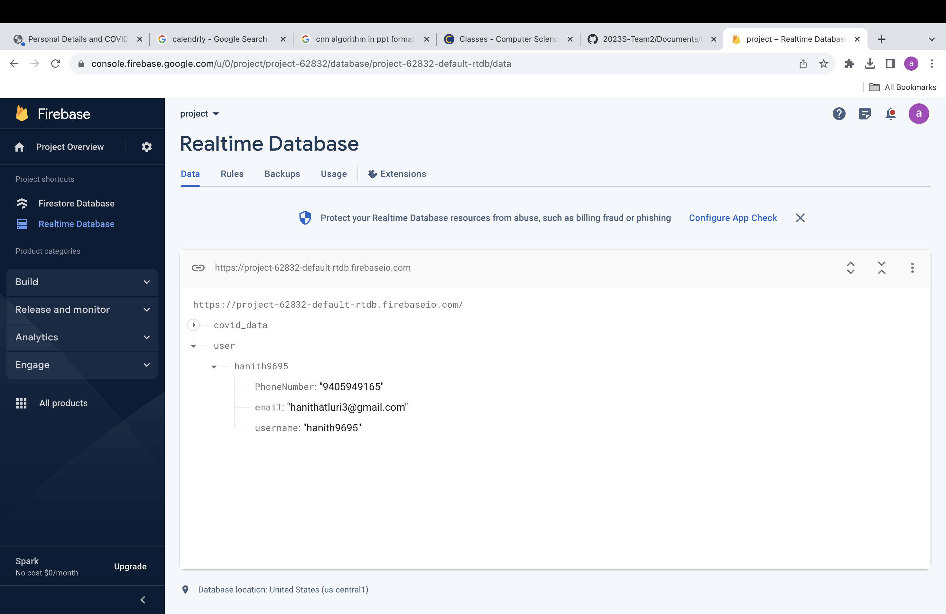
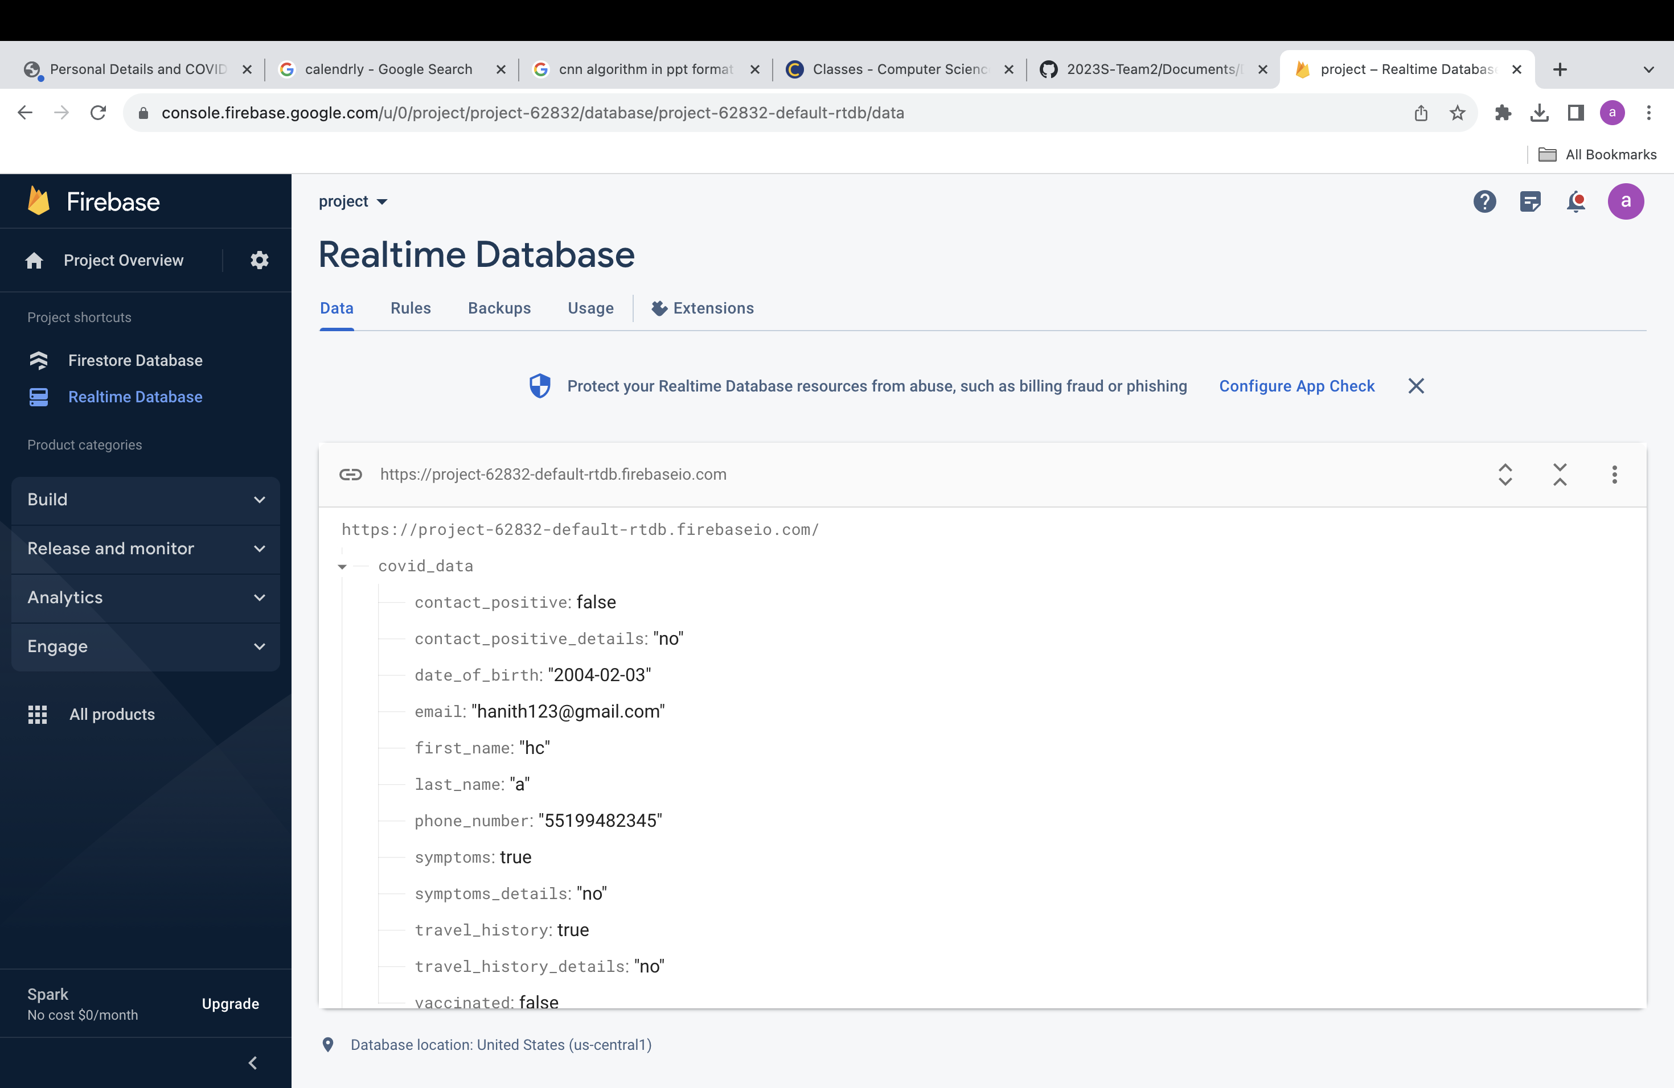
Firebase Authentication
When a new user establishes an account with Firebase Authentication, the server will generate data of a unique user ID (UID), both of which will be safely kept in the Firebase Authentication database.

Slide 37

demo

Slide 38
Retrospective
What went well: Effective teamwork was demonstrated by the members. Our team was able to solve the API problems we were having with our application, even though the sprint was short. Every modification was made on schedule, enabling team members to review each other's work.
What has to be improved: We have addressed every last detail of the video upload process, including the duration and appropriate placement of each and every module, in response to the input from the professors.
Upcoming actions: We intend to modify the application's front-end interface in order to enhance user experience and perception.

Slide 39
Thank you
Cs-692
Team 4 - Mission Possible
Github-Link

